Slide 1
Employee Attrition
How to know better our employees !
Rezart Abazi

Slide 2
Introduction:
The dataset used for this analysis contains HR data about past and current employees .
Some of characteristics of employees were collected such as Age, Gender , Marital Status from the personal life and Monthly Income, Job Role and so on from the job insight.
Exactly this dataset has 1471 observations and 35 variables.
Aim of this analysis is to uncover the factors that lead to employee attrition and explore important questions regarding the factors influencing the attrition.

Slide 3
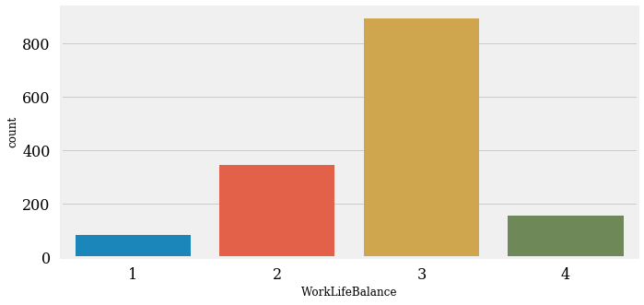
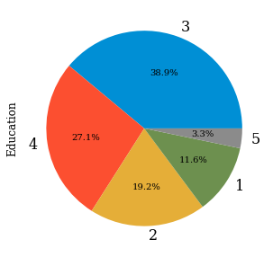
Analysis insight
Work-life balance: 1 = 'Bad'; 2 = 'Good'; 3 = 'Better;' 4 = 'Best'
Majority of the employees have there life balance at level 3,
there are around 5.4% employees who need to work on this.
Only 10.4% employees have there life completely balanced
Education
Education level: 1 = 'Below College'; 2 = 'College'; 3 = 'Bachelor'; 4 = 'Master'; 5 = 'Doctor'
Only 3.3% employee hold the highest education qualification.
Most of the employees have the education 'Bachelor'

Slide 4
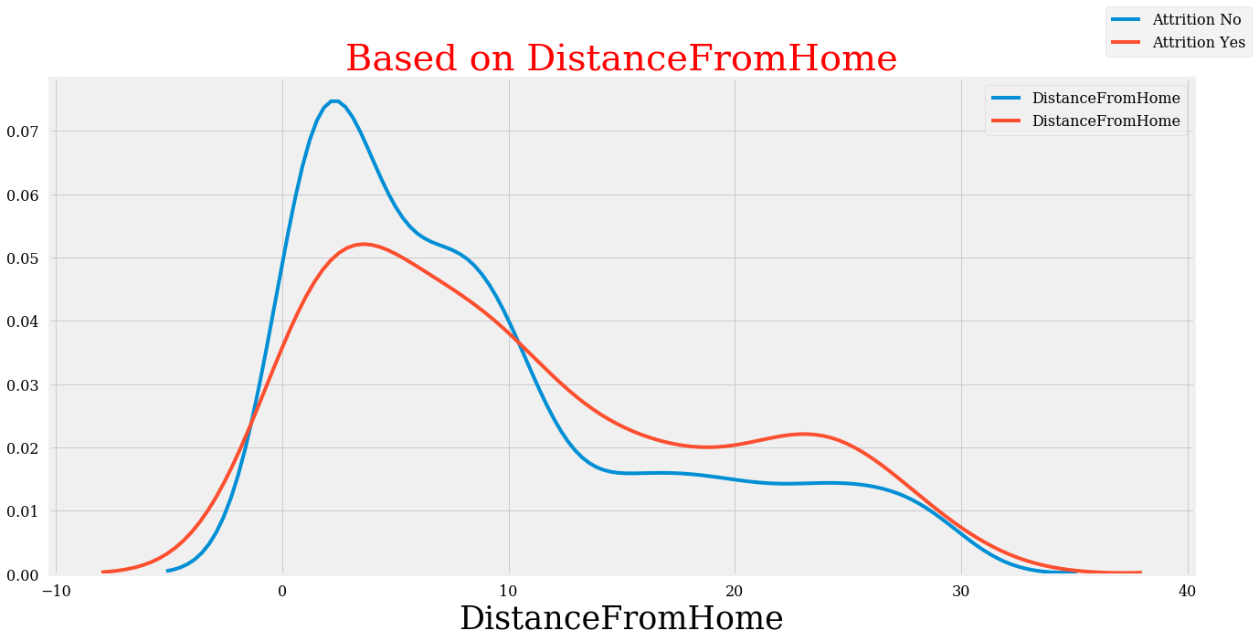
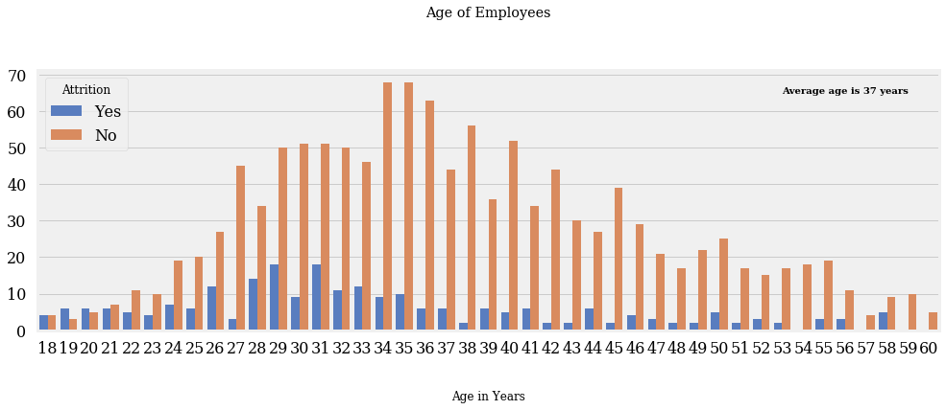
Analysis insight
A very important factor which was highlighted during the analysis was the distance from home.
We have a positive correlation here between the distance and the employees attrition where a higher distance between home and office will increase the probability to attrition.
Another factor affecting the attrition is the age where we can notice as if the majority of employees who leave the company are less than 40 years old.

Slide 5
Recommendations
In this presentation we included only an insight of all the analysis and all the factors.
Recommendations for improving the situation and creating an optimal situation where less employees choose to leave the company would be:
Closing the salary gap between male and female workers for bringing gender equality to our working environment .
Creating clear career path with more personalized offers for young people who join the company and offering them a prospective since they have the highest share of attrition.
For the employees who are living far from office offer a hybrid working model or in case that is not possible subsidiaries for the transport or for renting a car annually.

